Slide 1
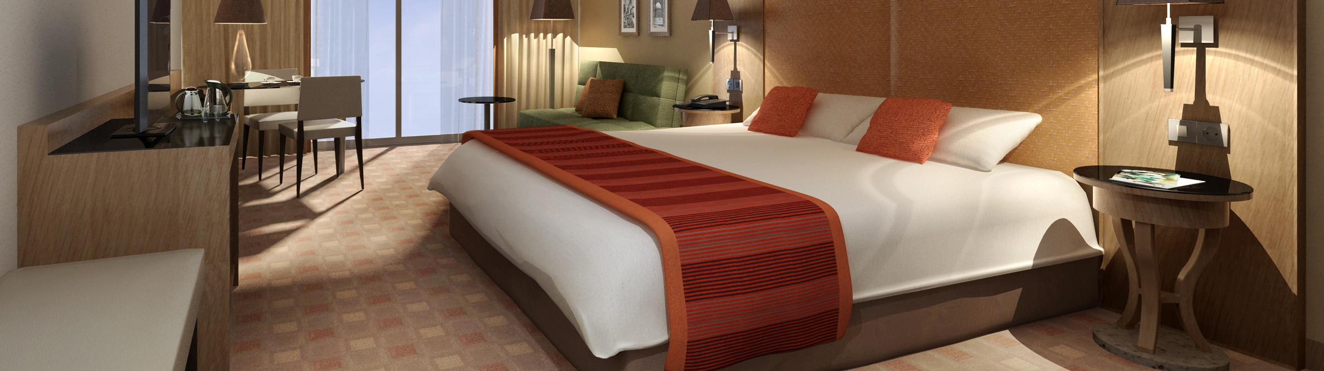
HOTEL REVENUE ANALYSIS

Slide 2
PROBLEM
Hotels struggle with data-driven decision-making because essential information (bookings, guest demographics, pricing, seasonal trends) is fragmented across multiple systems and lacks unified analysis.
This scattering results in poor visibility into key metrics like occupancy and rate performance, which hinders management's ability to optimize pricing, plan promotions, identify upsell opportunities, and maximize revenue.
The core need is for an integrated analytical solution that consolidates this data and delivers actionable insights via interactive dashboards to support strategic revenue decisions.

Slide 3

CONTENT
Module 1: Data Modeling and Ingestion
Module 2: Occupancy & Revenue Metrics
Module 3: Guest Analysis
Module 4: Forecasting & Cancellation Trends
Module 5: Revenue Strategy Dashboard

Slide 4

Module 1: Data Modeling & Ingestion
Transforming raw hotel booking data into a reliable, analytics-ready foundation that powers strategic decision-making across the organization.
Project Objective
Build a scalable, enterprise-grade data model that converts fragmented booking information into actionable business intelligence, enabling faster queries and consistent reporting across all departments.
Booking Transactions
Reservation records, payment history, and booking channels
Customer Profiles
Guest demographics, preferences, and loyalty status
Room Inventory
Room types, amenities, and availability data
Hotel Branch Information
Location details, capacity, and property attributes

Slide 5
Data Model (Star Schema)
A star schema organises data with a central fact table linked to dimension tables, enabling faster queries, simpler analysis, and scalable reporting.
DimCustomer
Customer ID
Name
Gender
Loyalty Tier
Country
DimRoom
Room ID (PK)
Room Type
Bed Count
Price per Night
Amenities
FactBookings
Booking ID (PK)
Room ID (FK)
Customer ID (FK)
Branch ID (FK)
Date ID (FK)
Revenue
Duration of Stay
DimDate
Date ID (PK)
Full Date
Day
Month
Year
Weekday / Weekend
DimBranch
Branch ID (PK)
Branch Name
Location
Star Rating
Manager Name

Slide 6
Business Rules & Derived Fields
1
2
3
Stay Duration Calculation
Formula: Stay Duration = Check-out Date − Check-in Date
Automatically computed for every booking to enable downstream analytics and customer segmentation.
Stay Type Formula
Day Use: 1 day (business travellers, hourly bookings)
Short Stay: ≤ 3 days (weekend getaways)
Extended Stay: 4–7 days (vacation travellers)
Long Stay: ≥ 8 days (corporate relocations, extended trips)
Room Category Logic
Standard: ≤ 3 days capacity (economy segment)
Deluxe: ≤ 6 days capacity (mid-tier comfort)
Premium: ≤ 10 days capacity (luxury experience)
Suite: > 10 days capacity (executive-level accommodations)

Slide 7
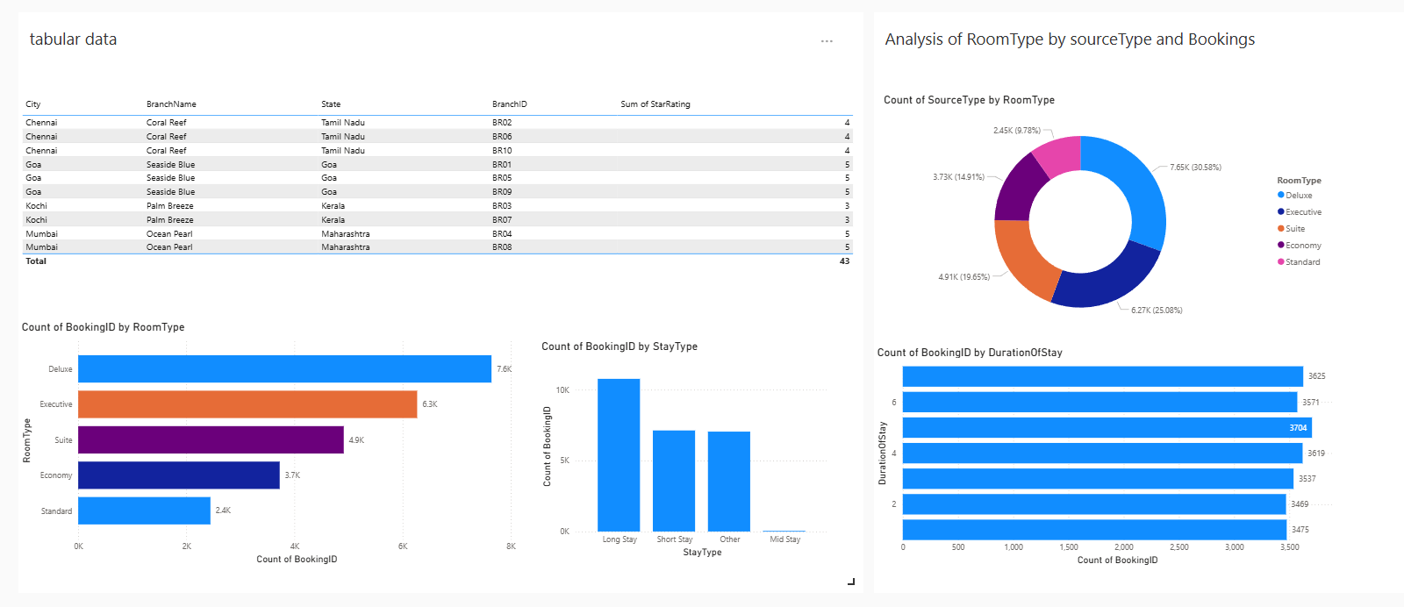
Module 1 Dashboard

Slide 8

MODULE 2 - OCCUPANCY & REVENUE METRICS
MODULE 2 EVALUATES HOTEL PERFORMANCE USING OCCUPANCY AND REVENUE KPIS LIKE OCCUPANCY %, ADR, AND REVPAR. IT ANALYZES TRENDS OVER TIME AND COMPARES BOOKING CHANNELS TO SUPPORT DATA-DRIVEN REVENUE DECISIONS.
KEY PERFORMANCE INDICATORS (KPIS) :
Occupancy % = (Rooms Sold ÷ Rooms Available) × 100
ADR (Average Daily Rate ) = Total Room Revenue ÷ Rooms Sold
01
02
Shows how many hotel rooms are occupied out of total available rooms.
➡ Helps measure room utilization efficiency.
Average revenue earned per sold room.
➡ Indicates pricing strength.
03
RevPAR (Revenue per Available Room) = ADR × Occupancy %
Combines Occupancy % and ADR to show overall revenue efficiency.
➡ Most important hotel performance metric.

Slide 9
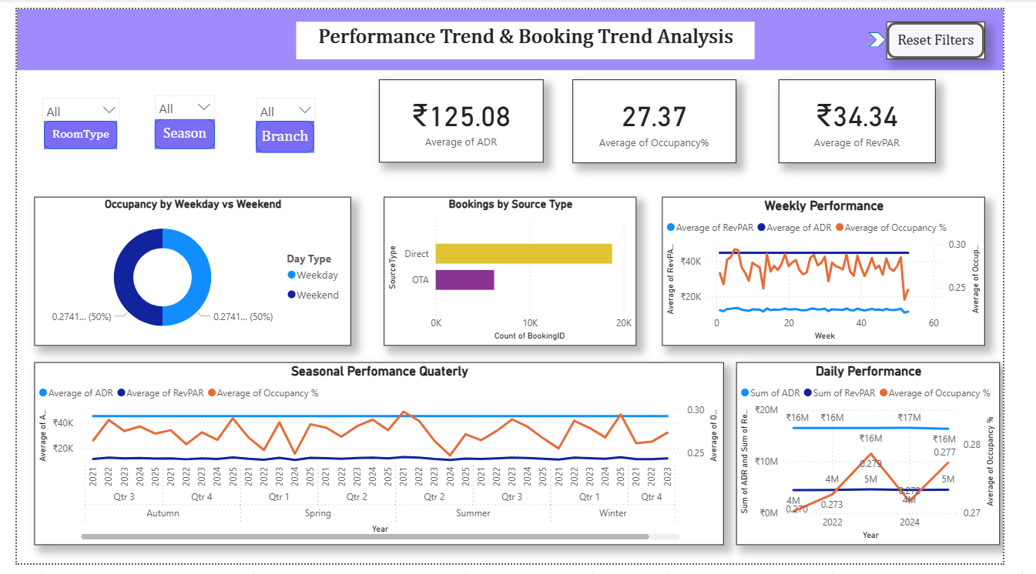

Slide 10

Impact – How KPIs Guide Revenue Decisions
Pricing Optimization
Occupancy % and ADR help adjust room prices based on demand levels.
01
Revenue Efficiency Evaluation
RevPAR provides a combined view of pricing and occupancy performance.
02
Demand & Capacity Planning
Trend analysis supports forecasting and better room inventory planning.
03
Channel Strategy Improvement
Direct vs OTA insights help reduce commission costs and improve profitability.
04

Slide 11
MODULE 3: GUEST ANALYSIS
Objective:
To analyze guest behavior and identify valuable customer segments for better decision-making.
01
Guest Segmentation:
Guests classified as Couple, Family, or Single based on purpose of visit.
02
Customer Clustering:
Identified High Spenders, Loyal Guests, and First-time Guests using booking history.
Demographic Analysis:
Guests grouped by age (Child, Teen, Adult, Senior).
03
Guest Value Metrics:
Used Recency, Frequency, and Spending data to measure guest importance.
04
Business Impact:
Helps hotels improve personalization, increase guest retention, and optimize revenue strategies.

Slide 12
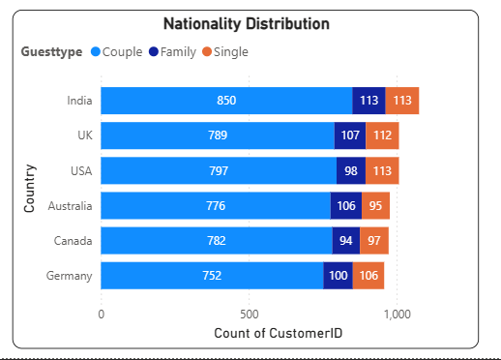
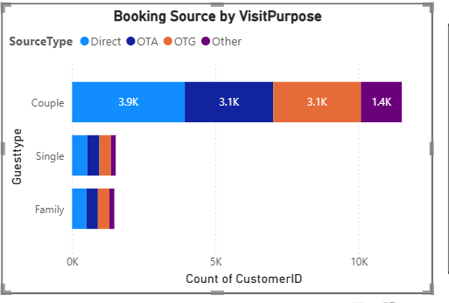
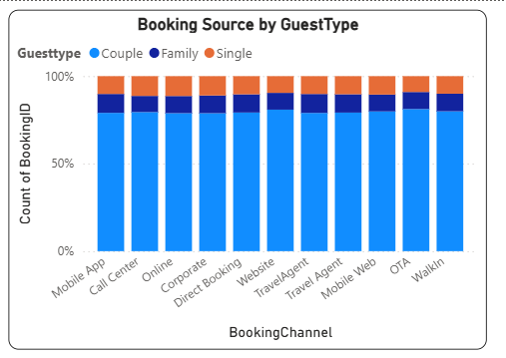
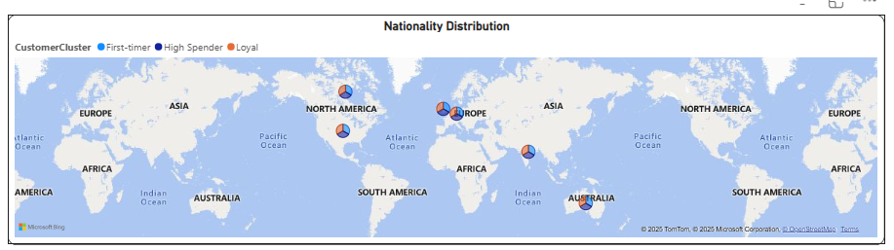
Module 3 Dashboard

Slide 13
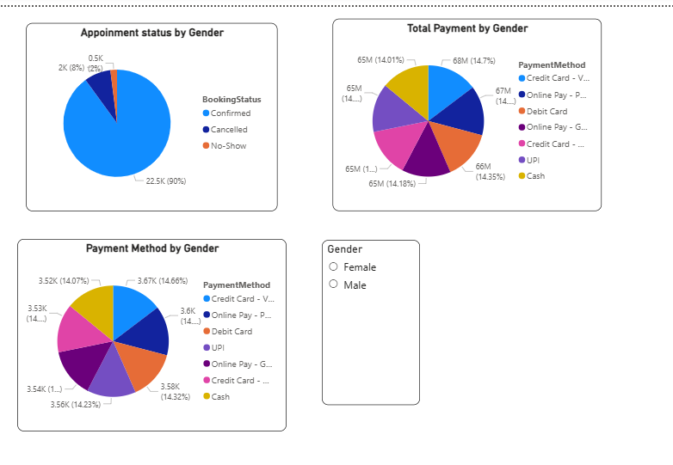
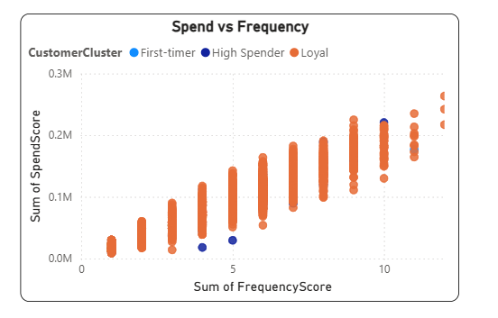
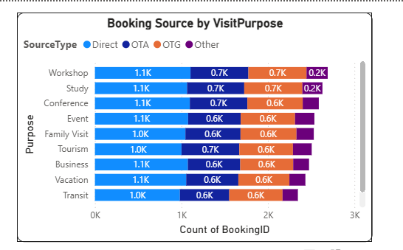
Module 3 Dashboard

Slide 14
POWER BI FORMULAS:
CustomerCluster =
SWITCH(TRUE(),
[NumOfBookings] = 1 && [Revenue] < 5000, "First-Timer", [NumOfBookings] >= 3 && [Revenue] < 15000, "Loyal Guest",[Revenue] >= 15000, "High Spender","Other")
GuestType = SWITCH(Customer[Purpose],"Honeymoon","Couple","Family Visit","Family","Business Trip","Single","Conference","Single","Tourism","Couple","Medical Visit","Single","Wedding","Family","Education Visit","Single","Sports Event","Family","Transit Stay","Single","Couple")
Key Insights:
High spenders contribute the highest revenue.
Loyal guests show frequent repeat bookings.
Couples and families are the dominant guest types.
India, UK, and USA are top source markets.
Digital payments are most preferred.

Slide 15
MODULE 4 : FORECASTING AND CANCELLATION TRENDS
OVERVIEW OF MODULE:
This module focused on analyzing booking behavior and operational risks that directly impact hotel revenue realization. The analysis uses key metrics and visualizations to support proactive revenue management strategies.
KEY INSIGHTS DELIVERED:
Occupancy Forecasting (Future Scope): Predicting future occupancy levels.
Cancellation Rate: Tracking the proportion of canceled bookings.
Lead Time Distribution: Understanding the duration between the booking date and check-in date.
Refund and No-show Behavior: Quantifying lost revenue from refunds and guests who don't arrive.

Slide 16
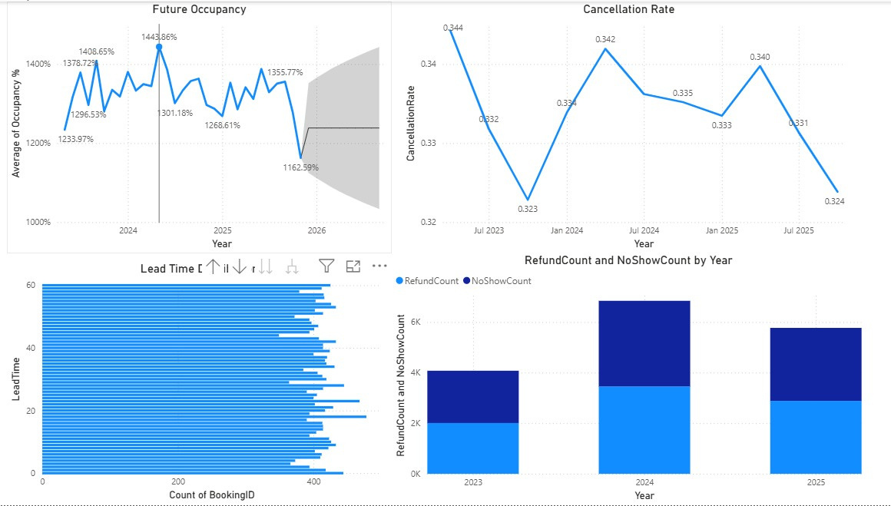
FORECASTING AND CANCELLATION INSIGHT
FUTURE OCCUPANCY: THE AVERAGE OCCUPANCY PERCENTAGE IS HIGHLY VOLATILE, WITH THE 2026 FORECAST FALLING BETWEEN APPROXIMATELY 1100% AND 1200%.
CANCELLATION RATE: THE RATE FLUCTUATES MODERATELY, RANGING FROM ABOUT 0.323 TO 0.344 ACROSS THE PERIOD FROM JULY 2023 TO JULY 2025.
LEAD TIME: THE MAJORITY OF BOOKINGS HAVE A SHORT LEAD TIME, TYPICALLY BETWEEN 0 AND 60 DAYS.
REFUND/NO SHOW TREND: BOTH REFUND COUNT AND NO SHOW COUNT PEAKED IN 2024 BUT SHOW A DECREASE IN 2025.
T

Slide 17

KEY MEASURES & CALCULATIONS USED IN POWER BI
Occupancy %
Measures the percentage of available rooms that are occupied, indicating room utilization efficiency.
Occupancy % = DIVIDE([Room Booked], [Total Rooms]) * 100
2.Cancellation Rate
Measures the proportion of bookings that are cancelled, indicating booking reliability.
Cancellation Rate =DIVIDE(COUNTROWS(FILTER(Bookings,
Bookings[CancellationFlag] = "Yes") ),
COUNTROWS(Bookings))
3.Lead Time
Measures the number of days between booking date and check-in date, reflecting customer booking behavior.
Lead Time =DATEDIFF(Bookings[BookingDate],Bookings[CheckInDate], DAY)
4.Refund Count
Measures the total number of refunded bookings, highlighting revenue leakage.
Refund Count =CALCULATE(COUNTROWS(Bookings),
Bookings[RefundAmount] > 0)

Slide 18
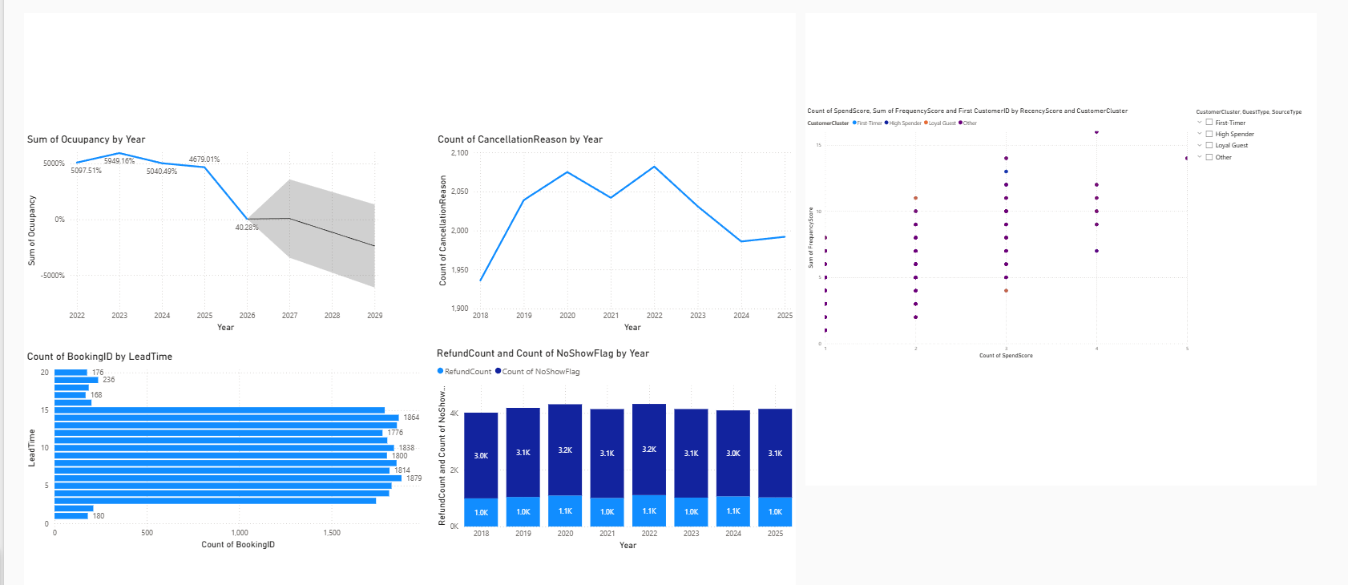
Module 4 Dashboard

Slide 19
Module 5: Revenue Strategy Dashboard
AI-Driven Pricing & Upsell Analytics for Hotels
Key Focus:
Centralized Power BI dashboard for revenue decisions
Combines room pricing and ancillary upsell analytics
Designed for General Managers & Revenue Managers
What Problem It Solves:
Identifies missed upsell opportunities
Optimizes seasonal & room-type pricing
Replaces guesswork with data-backed decisions

Slide 20
Upsell Potential – Ancillary Services
1. Upsell Potential (Ancillary Services)
Analyzes guest spend on spa, dining, services
Identifies high-value & repeat guests
Highlights high-margin but underperforming outlets
2. Pricing Tiers (Seasonal + Room Type)
Peak season → premium pricing
Weekends → mid-tier pricing
Off-season → discounts & bundles
Different pricing logic per room category

Slide 21
Scenario Testing & Business Impact
Interactive Decision-Making
What-If Parameters
Price Uplift %
Occupancy Sensitivity (demand elasticity)
Scenario Demo
Baseline vs adjusted ADR, Occupancy, RevPAR
Real-time KPI updates using sliders
Impact for Managers
Higher ADR & RevPAR
Improved upsell conversions
Faster, confident pricing decisions
Reduced dependency on intuition

Slide 22
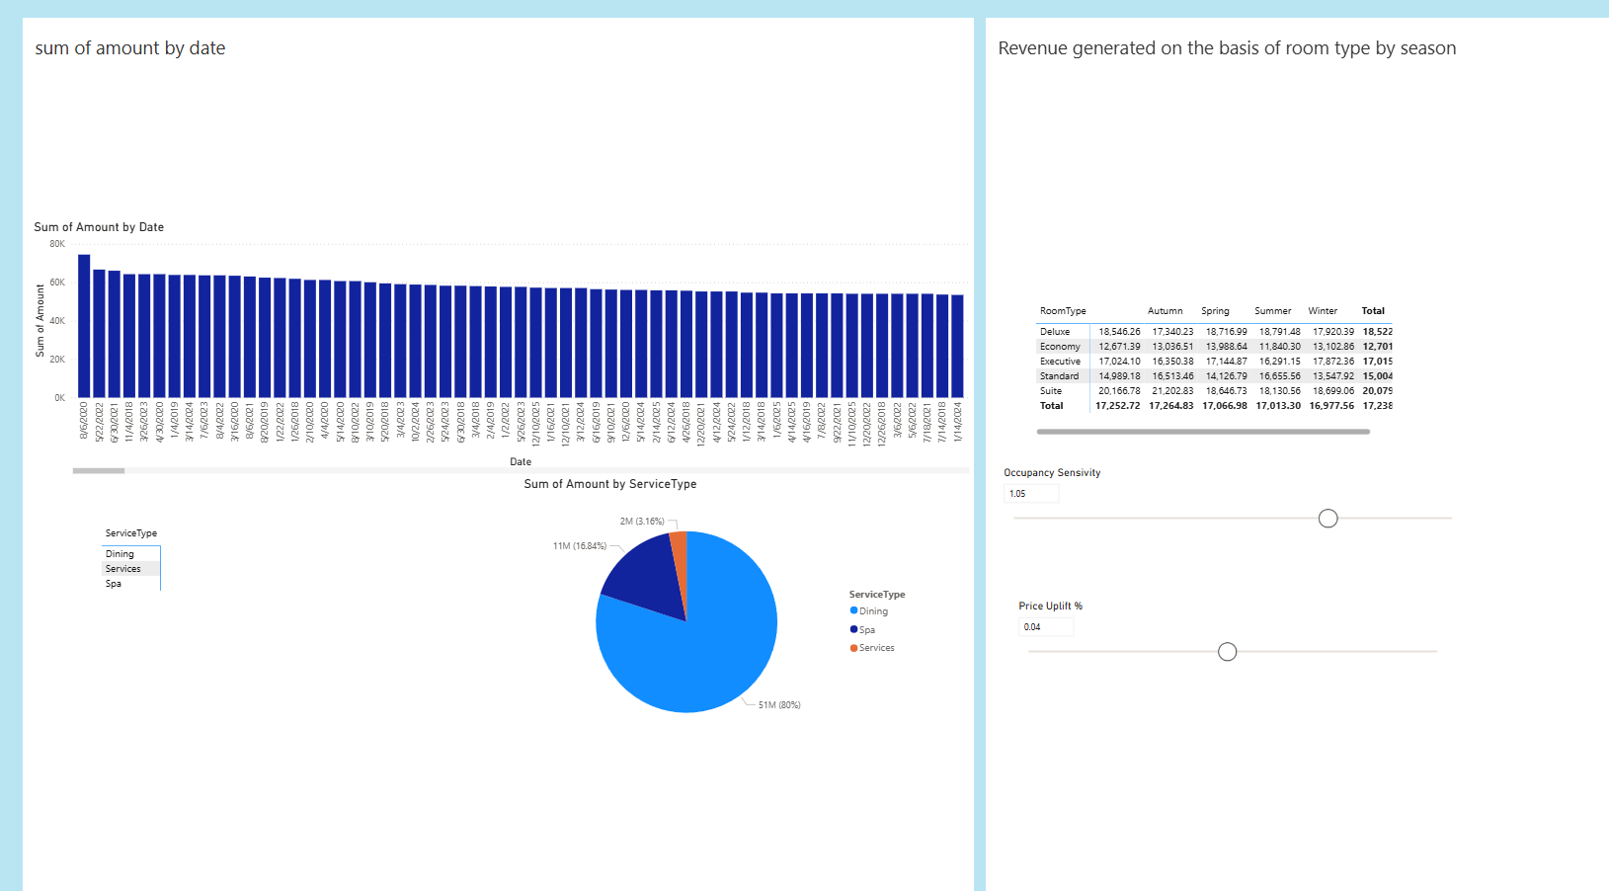
Module 5 Dashboard

Slide 23
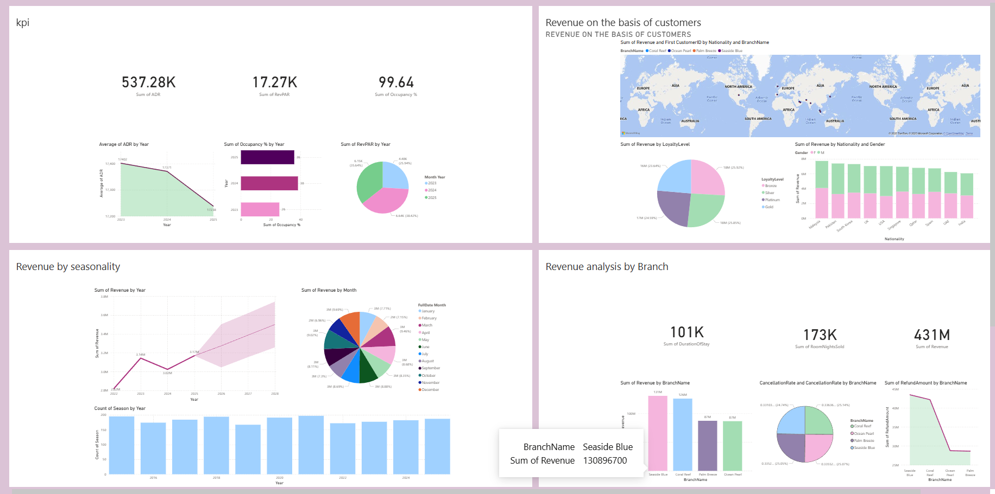
Revenue Manager Dashboard

Slide 24
Revenue Manager Dashboard
DESPITE A SLIGHT DECLINE IN ADR, STABLE REVPAR AND IMPROVING OCCUPANCY INDICATE EFFECTIVE ROOM UTILIZATION AND RESILIENT REVENUE PERFORMANCE.
Revenue growth is steady with mild seasonality, driven largely by high-value customer segments such as key international markets and Gold/Platinum loyalty members.
Performance varies across branches, and higher cancellations and refunds at certain locations highlight opportunities to improve booking policies and customer experience.
General Manager Dashboard
Bookings are stable week-to-week with seasonal peaks, driven mainly by Solo and Business travelers, while Family and Corporate segments remain underutilized.
Long stays and Vacation travel generate the highest value, contributing most to room nights sold and overall revenue.
Suite and Premium rooms are the key revenue drivers, while Economy rooms offer stable but low-margin occupancy.

Slide 25
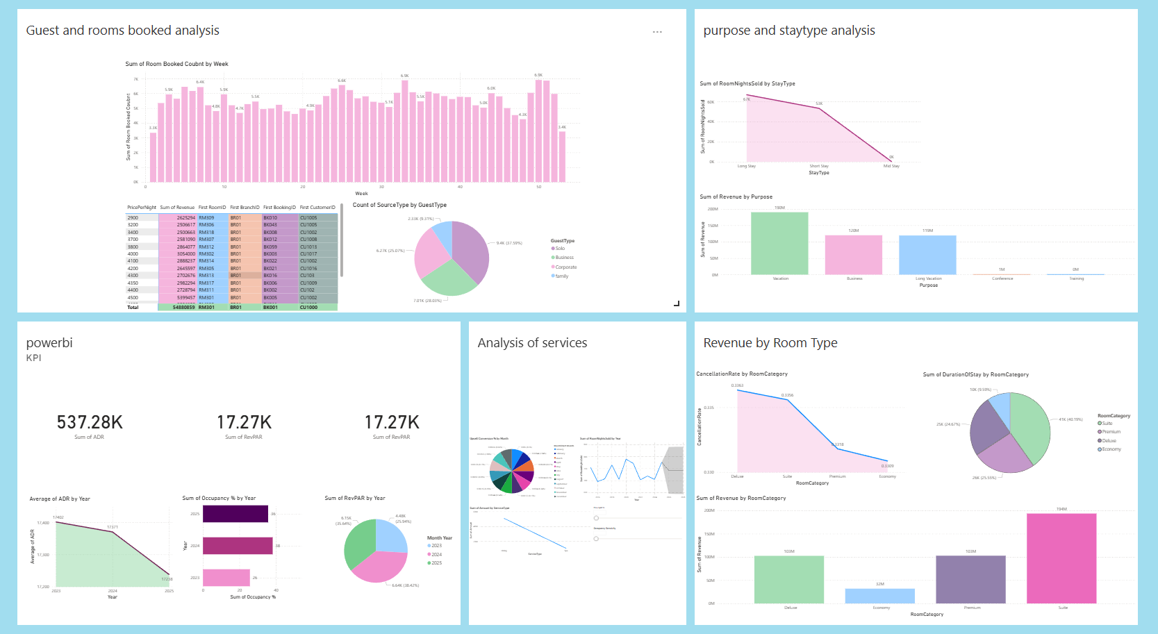
General Manager Dashboard

Slide 26

THANK
YOU

